Slide 1
ITSC 203:
Offensive and Defensive Tool Construction
Module 3: Advanced features of Python (REGEX)
Notes:
1

Slide 2
Regex
Extracting information from text to provide special meaning can be a difficult preposition. The challenge is how do we recover information beyond simple statements like:
if "hello" in "my hello to you": print("Contains hello")
I can use the above to find that the string contains hello or “my hello to you”.find(“hello”) to find where in the string that occurs.
Now what if we wanted to validate an email, phone number or extract parts of that once validated. Although we could program those features there are more clever ways to handle this.
REGEX!!!

Slide 3
Regex
Think about the following phone numbers a user could enter into your program:
413-444-5556
403.343.2347
403 123 2321
4032221345
(587) 222 1234
(587) 222-1234
(587)4221234
How can we extract the area code or determine if there are sufficient digits?
The assumption is that you will always get a Canadian formatted phone number. This will reduce the complexity required.

Slide 4
Regex
Before we can go about solving this challenge we need to speak the regular expression language.
https://docs.python.org/3/library/re.html
https://www.tutorialspoint.com/python/python_reg_expressions.htm
Regular expressions can be challenging to make sense of, so let’s start with a few. In order to get proficient you must practice the skill.
Common Special Characters:
. - any character except newline * - 0 or more characters + - 1 or more characters | () - group match
 | \d - any numeric digit
 | \s - any space \t\n\r\f\v
? - 0 or more repetition of pattern | \w - any of these 0-9a-zA-Z_
{m} – exactly m occurrence
{m,n} – match m to n occurrences
\ - escape sequence for special characters
[ ] - set of characters
| - match either regular expression

Slide 5
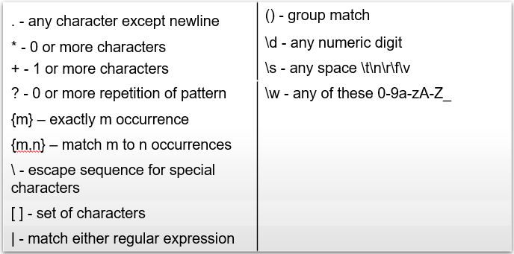
Regex
Let’s say we are looking for a sequences that starts with a number and is followed by a string of characters:
So for a string: “12345 is the number __”
Regular expression pattern: \d+\s\w+\s__
What about the following string:
“12345 is the number __ 12345 is the number__”
Regular expression pattern: \d+\s[\w+\s]+__
>>> import re
>>> str1 = "12345 is the number __"
>>> matches = re.match(r'\d+\s\w+\s_+', str1)
>>> matches
>>> # no matches found
>>> matches = re.match(r'\d+\s[\w+\s]+_+', str1)
>>> matches
<re.Match object; span=(0, 22), match='12345 is the number __'>
>>> # match found
>>> matches.string
'12345 is the number __’
>>> str2
" 12345 match will it __\nHow about this\n4567 match won't it
\n34509 no __ what about this\n"
>>> matches2 = re.search(r'\d+\s[\w+\s]+_+', str2)
>>> matches2
<re.Match object; span=(1, 23), match='12345 match will it __'>
>>> matches2 = re.findall(r'\d+\s[\w+\s]+_+', str2)
>>> matches2
['12345 match will it __', '34509 no __']

Slide 6
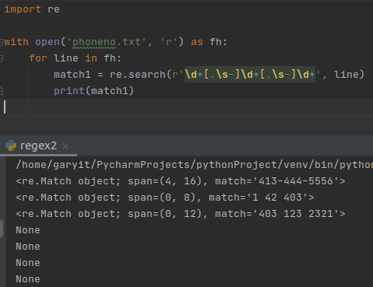
Regex
What about finding matches for phone numbers and extracting the area code:
File contains the following lines
aabb413-444-5556
1 42 403.343.234
403 123 2321
4032221345
1(587) 222 1234
(587) 222-1234
(587)4221234
The image to the right shows one
possible pattern that could be use
to search for phone numbers. Notice that
there is an error in the results produced.
The search creates a regular expression match
object but some of the results are not correct
and others are ignored. Before proceeding think
about to eliminate the second option.

Slide 7
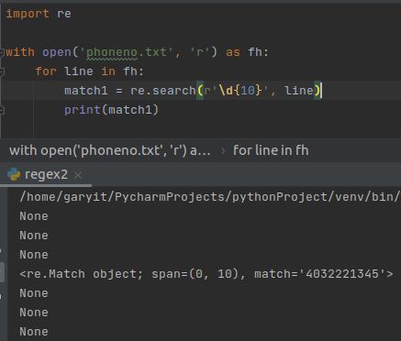
Regex
What about finding matches for phone numbers and extracting the area code:
File contains the following lines
aabb413-444-5556
1 42 403.343.234
403 123 2321
4032221345
1(587) 222 1234
(587) 222-1234
(587)4221234
See the revised code on the left. Use the results
to revise the original code on page 6. This will help
to find North American phone numbers.

Slide 8
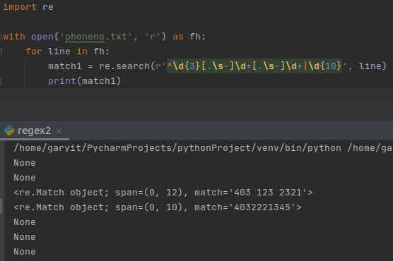
Regex
What about finding matches for phone numbers and extracting the area code:
File contains the following lines
aabb413-444-5556
1 42 403.343.234
403 123 2321
4032221345
1(587) 222 1234
(587) 222-1234
(587)4221234
See the revised code on the left. What
conclusion can you draw from the output
generated on the right about the symbols
| and ^.

Slide 9
References
Python Top-Level manual URL:
https://docs.python.org/3/
Python Standard Library manual URL:
https://docs.python.org/3/library/index.html
Python Language Reference URL:
https://docs.python.org/3/reference/index.html
Python Tutorial URL:
https://docs.python.org/3/tutorial/index.html
Miscellaneous:
https://stackoverflow.com/questions/2927993/where-are-the-python-modules-stored

